Slide 1
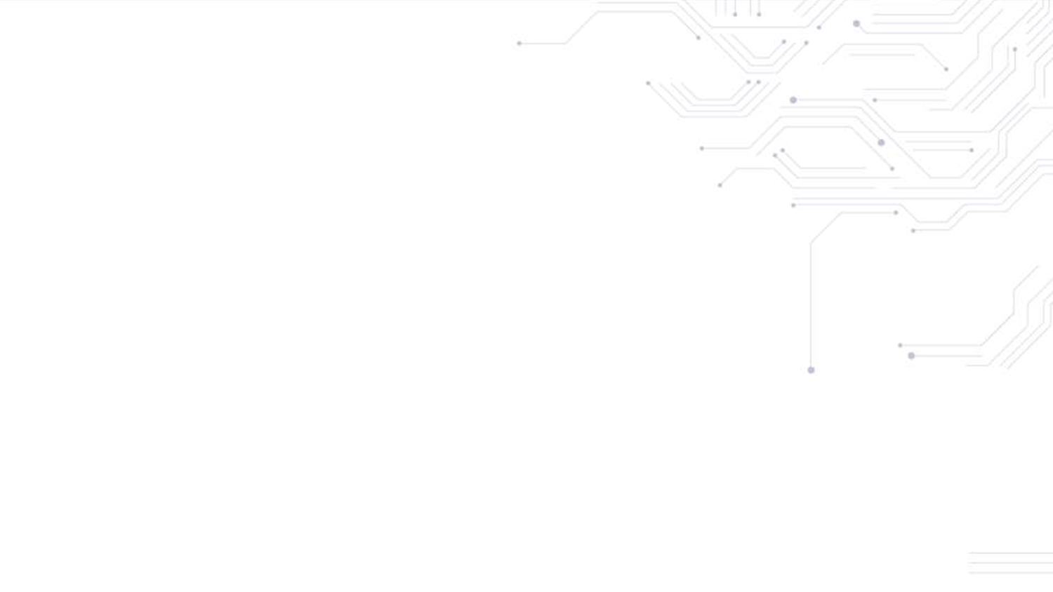
ZSL: Zero-Knowledge Security Layer
1

Slide 2




zk-SNARKS
zk-SNARK refers to “Zero-Knowledge Succinct Non-Interactive Argument of Knowledge.”
It allows verification of computational correctness without declaring the knowledge of what was
executed among the parties.
zk-SNARK works on zero-knowledge proof.
It eventually allows private smart contracts to run on a public blockchain.
INPUT
Zero Knowledge Proof of Validity
OUTPUT
INPUT
OUTPUT
Details requested to construct a Zero Knowledge Proof
?
?
?
Details requested to construct a Zero Knowledge Proof
Zero Knowledge Proof of Validity
TRANSACTION VERIFICATION IN ZCASH

Slide 3

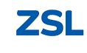
ZSL
ZSL enables transferring of digital assets without publishing any information of the sender, receiver,
and the quantity of assets.
It ensures the authorization of the sender to transfer the ownership of assets.
ZSL removes double-spend issue of assets.
It ensures mass conservation, i.e. transaction input equals its output.

Slide 4
ZSL Components
Z-contracts: A contract that supports the issuance of z-tokens that can be exchanged privately
and transparently using ZSL technology.
Private Contract: Trade Parameters like buyer, seller, and the trade lifecycle is defined in the private contract.
zk-SNARKS Prover:
SNARK prover by the
The creation of z-transactions requires zk- sender who includes proof as part of the transaction that
was broadcasted to the network.
zk-SNARKS Verifier: Verifies zk-SNARK proofs attached to the transaction.

Slide 5


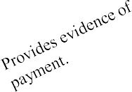
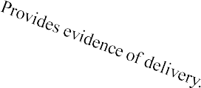




ZSL Example
Private Contract is established between Alice & Bob.
1
2
Bob sends transaction indicating acceptance of terms.
Constellation
Private Contract
Private Contract instructs Delivery
Private Contract instructs Payment.
3
5
9
7
6
10
ALICE
(BUYER)
BOB
(SELLER)
Private Contract
verifies payment.
Private Contract
verifies delivery.
USD
(Z-Contract)
ACME
(Z-Contract)
Bob delivers ACME shares to Alice.
Alice pays USD to the Seller.
4
8
11

Slide 6
THANK YOU!

